Slide 1
7-Connecting to Instances

Slide 2
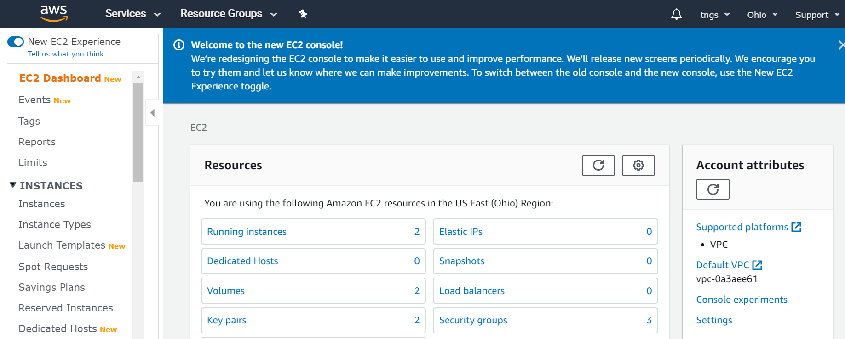
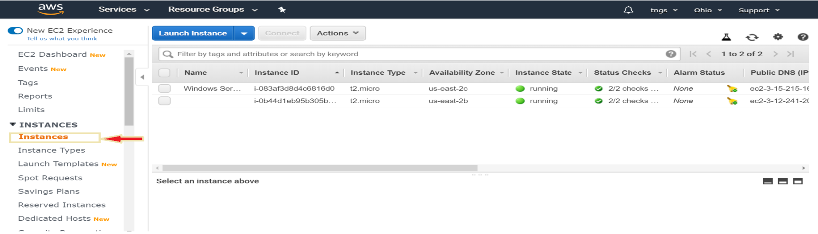
CONNECTING TO WINDOWS INSTANCE
Under Services drop down list, choose EC2 from compute section, then make sure you are in the region where you created the instances.
Next, from the left pane select Instances under INSTANCES section to list the instances.

Slide 3
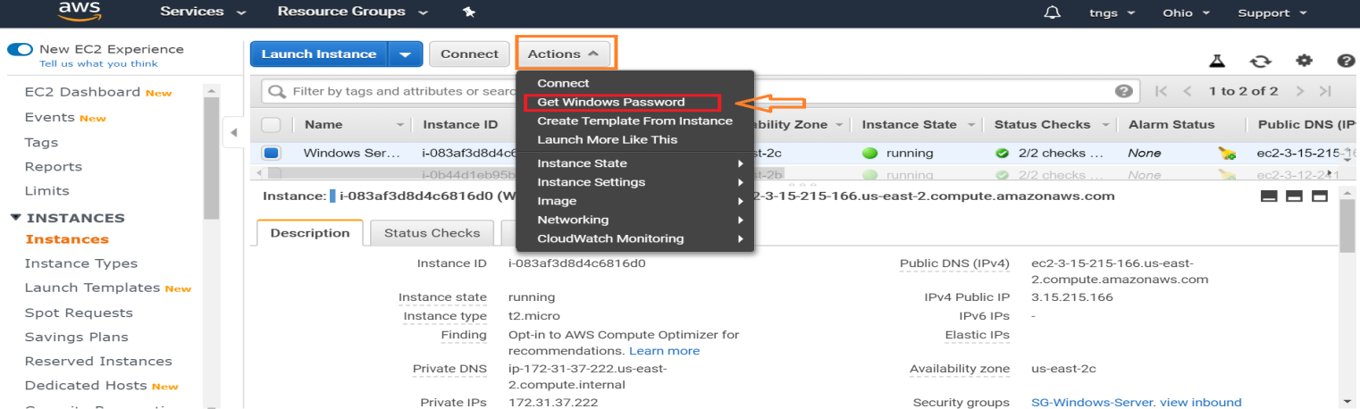
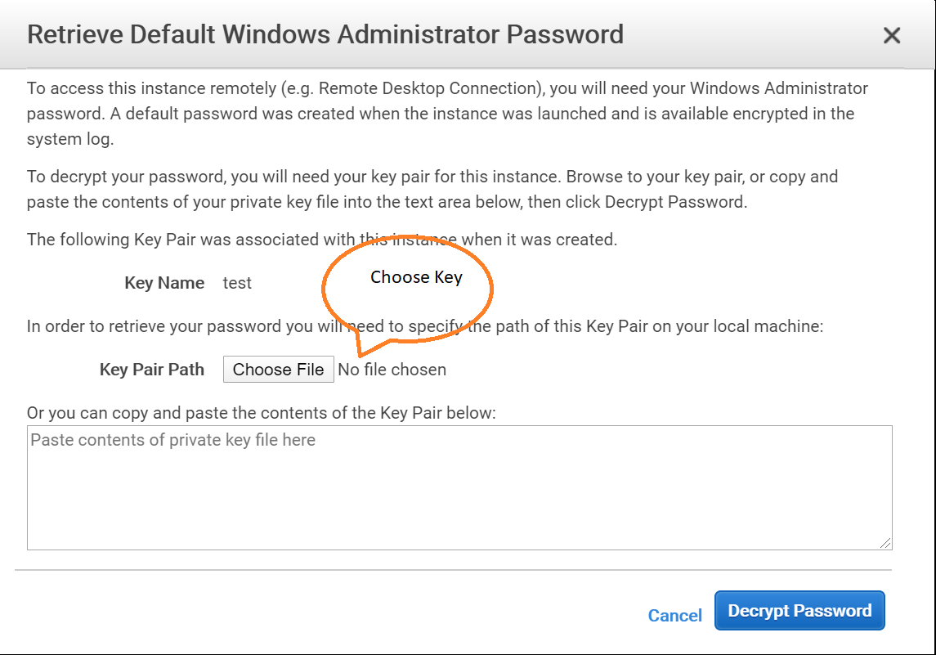
Next, select your windows instance from the instances list then select Get Windows Password from the Actions tab drop down list.
Retrieve windows password dialog box will open, choose Browse and select your PEM key pair.

Slide 4
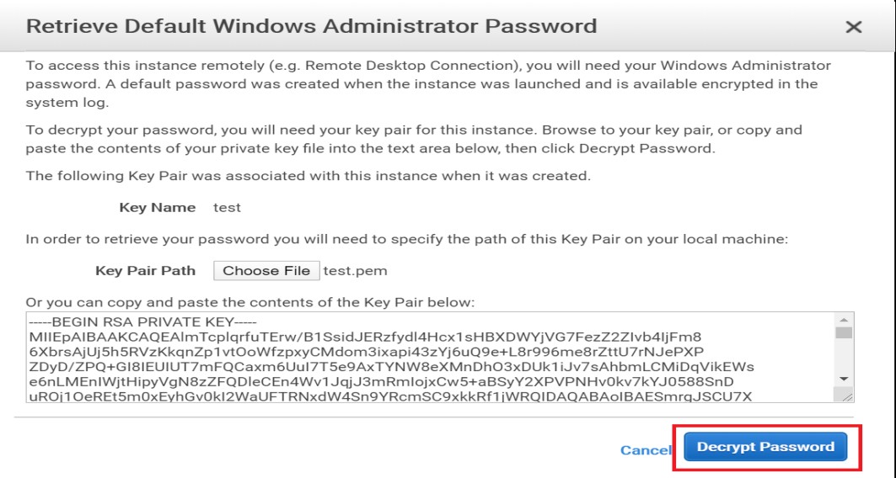
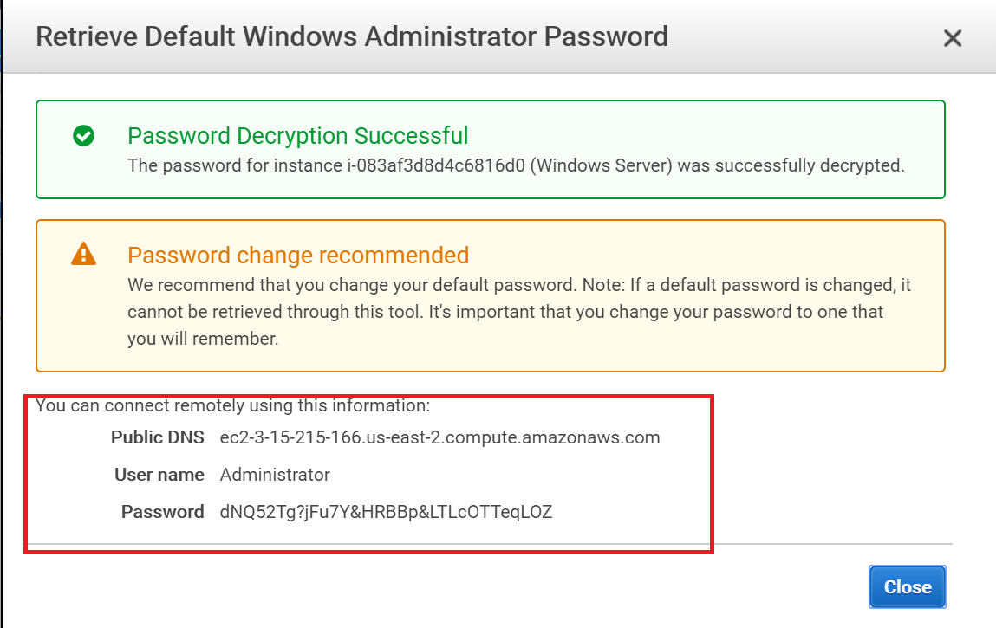
Next, click on Decrypt Password to get the password.
You will get the credential information to connect to the windows instance.

Slide 5
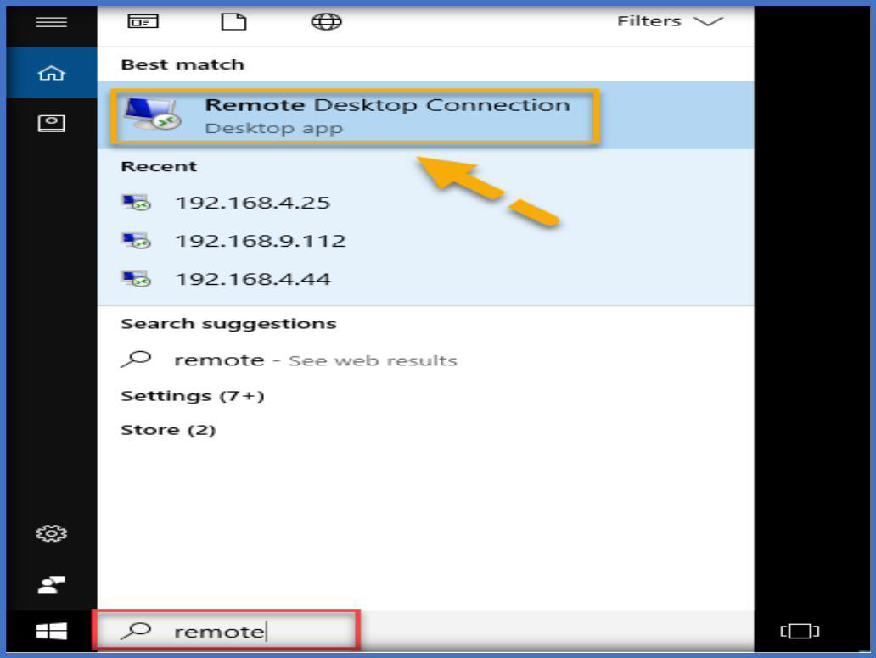
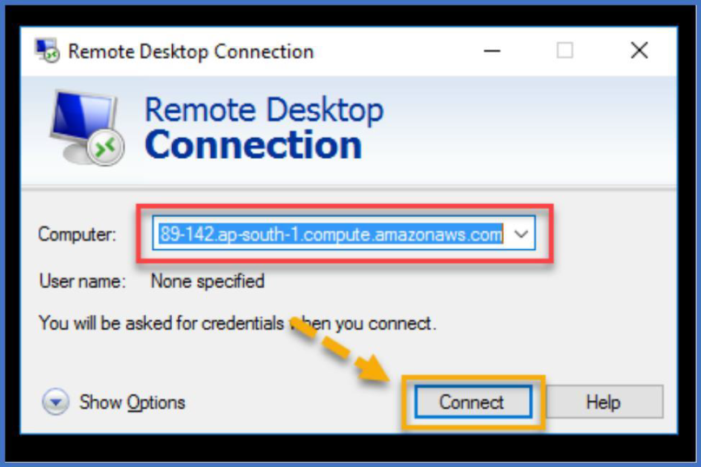
Now open remote desktop app in your desktop to connect to the windows instance on AWS. To open the remote desktop app, search for remote desktop in the windows search like below.
Once remote desktop app opened, copy and paste the public DNS in the computer text box and click on connect to connect to the instance.

Slide 6
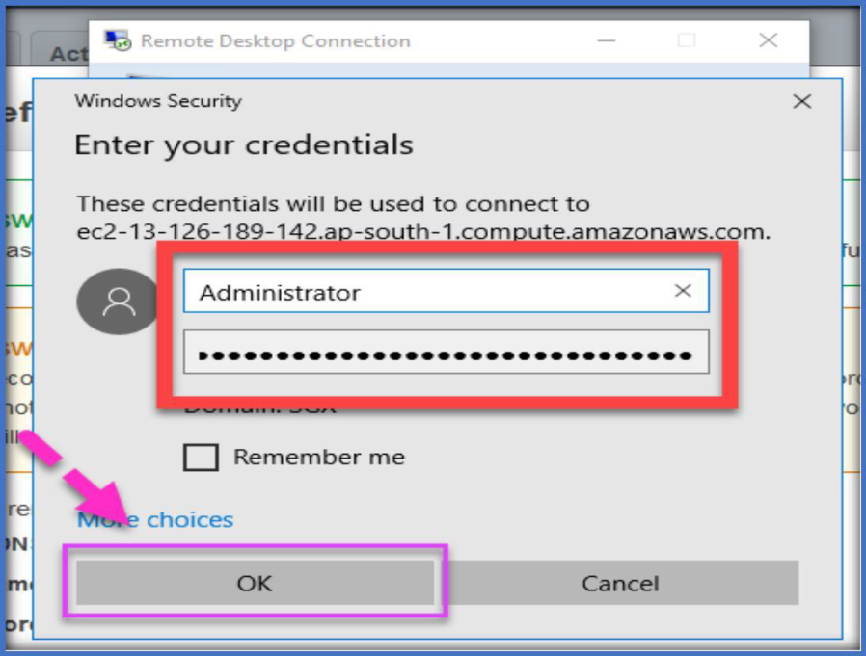
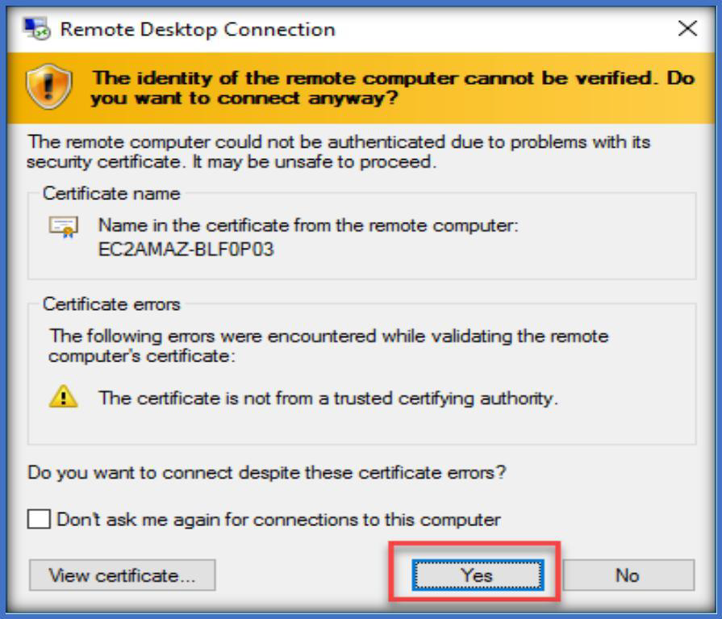
Specify the username and password in the respective fields and choose OK to connect.
Then choose yes to connect.

Slide 7
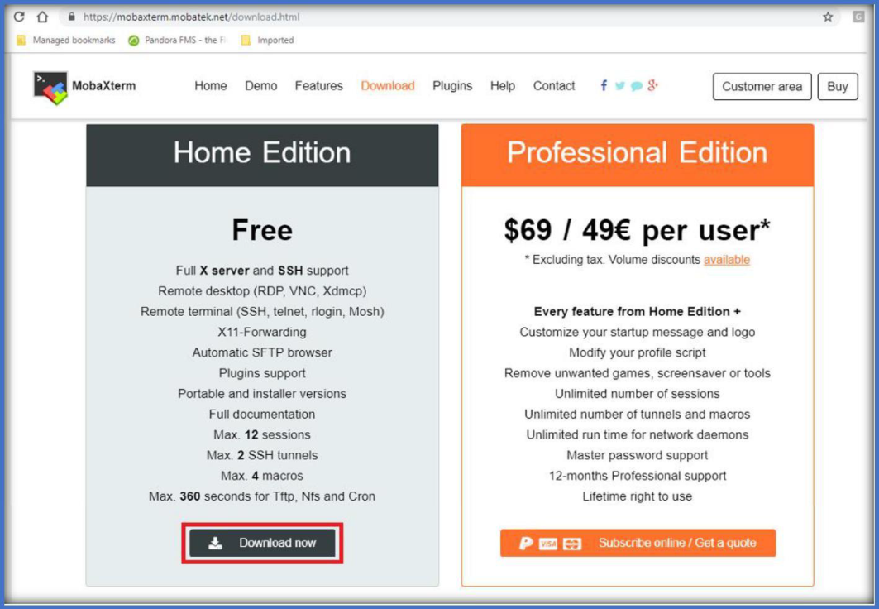
CONNECTING TO LINUX INSTANCE
To connect to Linux instance, we need an app like remote desktop for windows. There are two applications called putty or mobaxterm, we can use any one to access the Linux instances.
ACCESSING USING MOBAXTERM:
You can download the mobaxterm app from below link.
https://mobaxterm.mobatek.net/download.html
Once opened clock on download on Home Edition to download which is free.

Slide 8
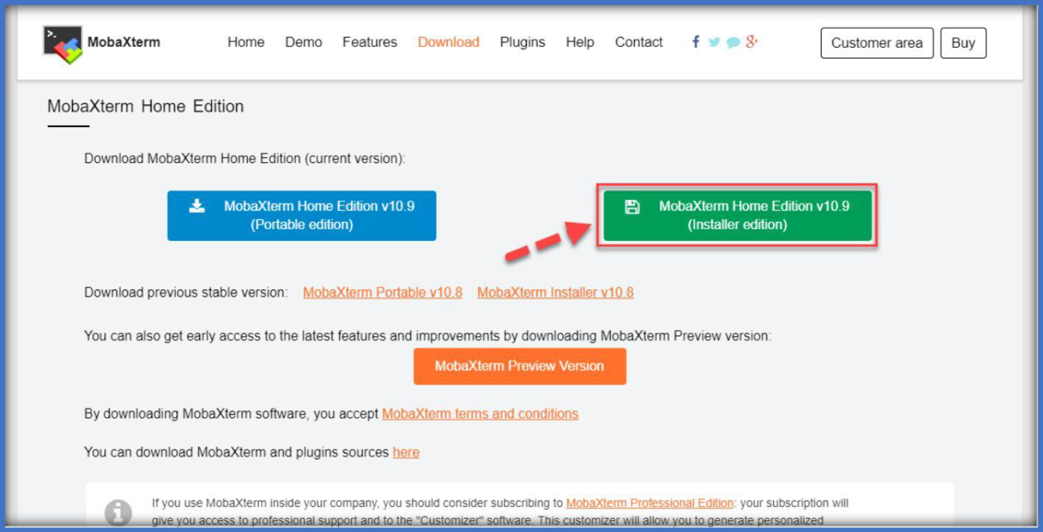
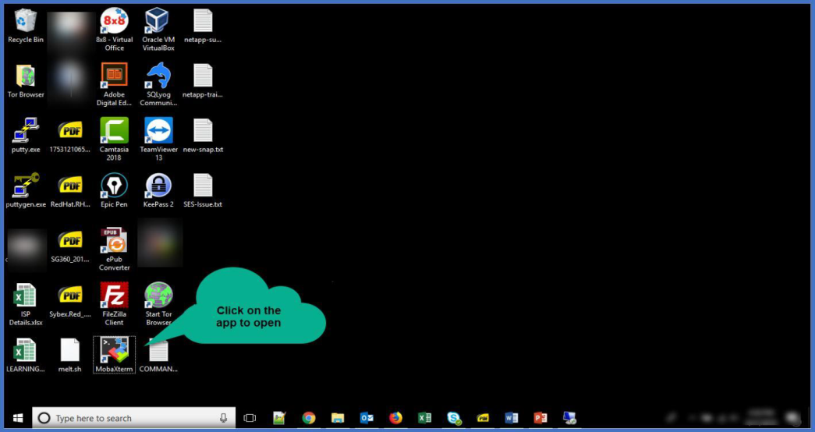
Click on the MobaXterm Installer edition to download, once downloaded extract the zip file.
Install the app using the MobaXterm_installer_10.9.msi file. once installed open the app using the short cut on the desktop.

Slide 9
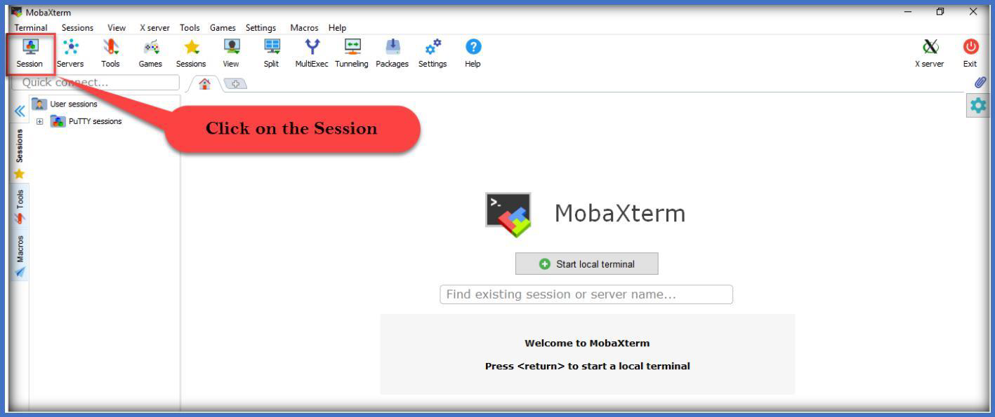
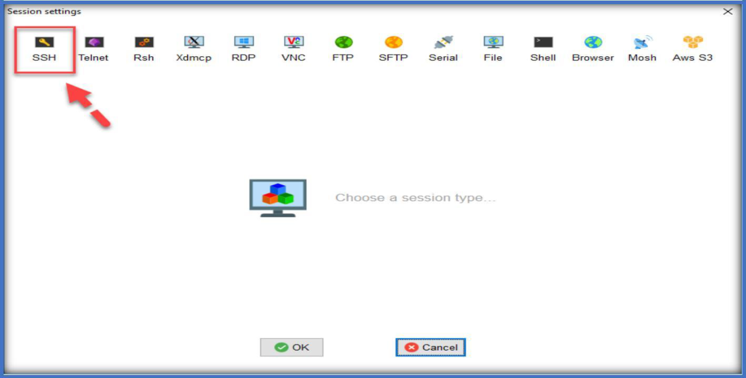
Once app opened, click on the Session on the left side top corner of app.
Choose SSH from the session settings wizard.

Slide 10
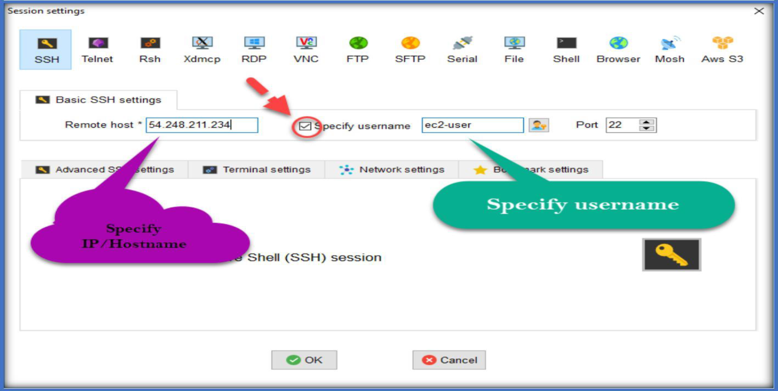
Specify the IP/Hostname at the Remote host text box, Select the Specify username option and fill the username.
Select advanced SSH Settings bar, select use private key, then mouse over to the end of the text box, you will find a search icon click on it to load the key pair.

Slide 11
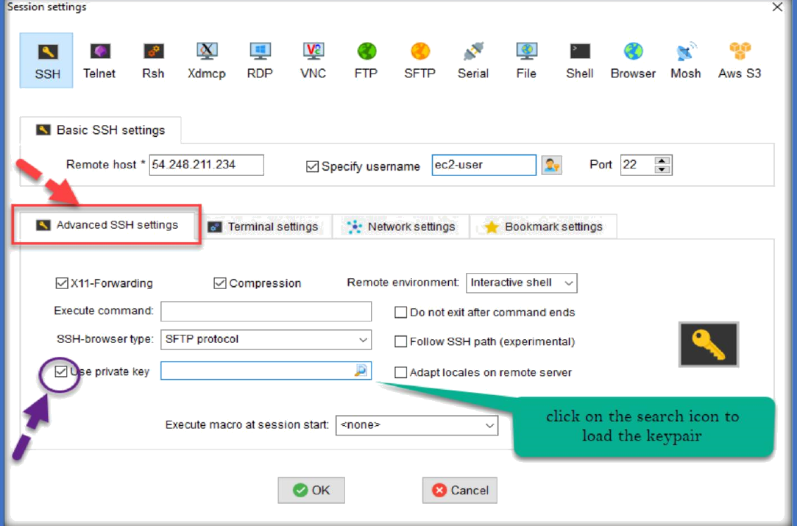
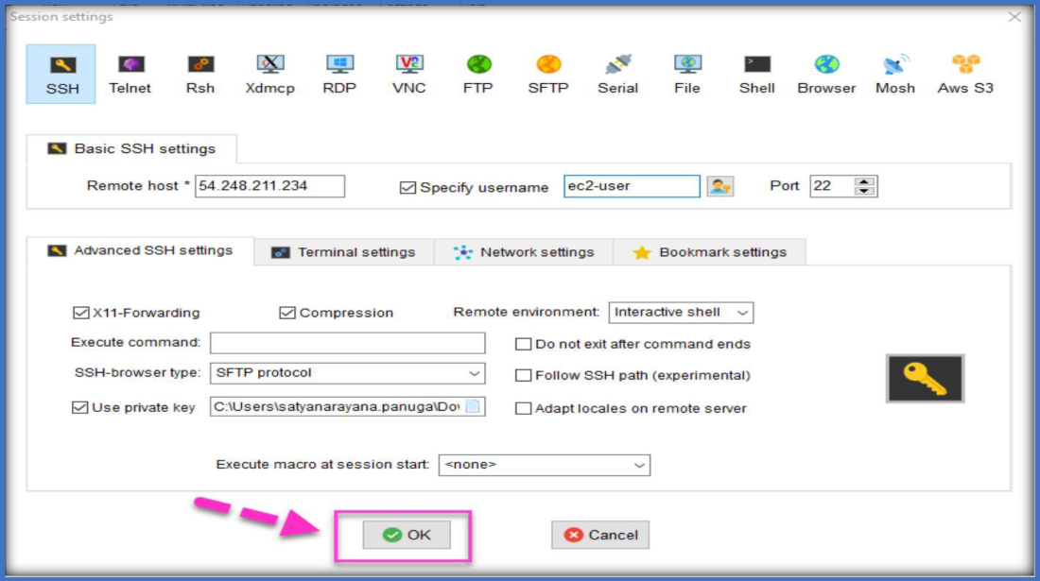
Choose the PEM file click on open
Next, click on OK to connect to the Linux server

Slide 12
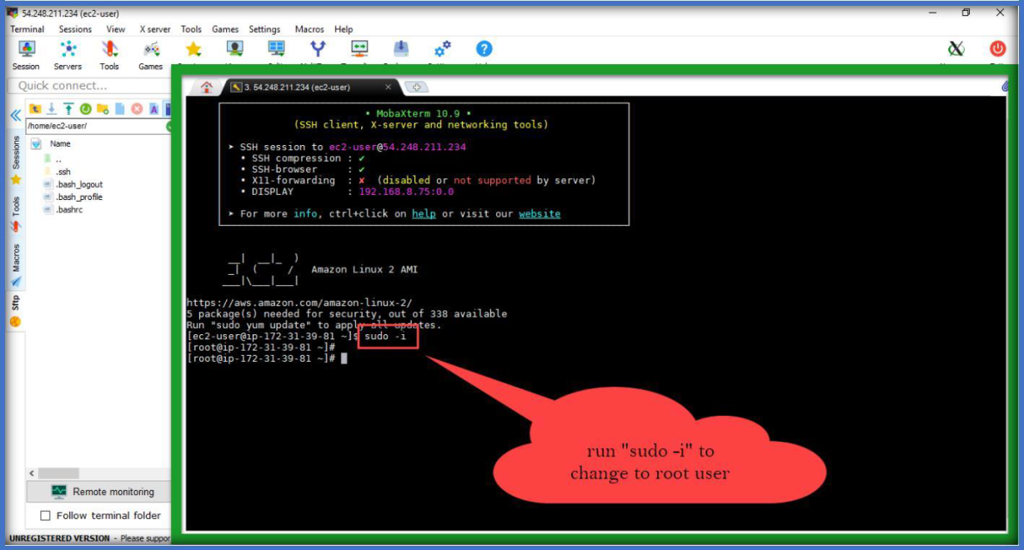
Once clicked on OK, you will be connected to Linux server, then use “sudo -i” command to log in to root user.
CONNECT USING PUTTY APPLICATION:
Download Putty.exe and Puttygen.exe from below URL and open it.
http://www.chiark.greenend.org.uk/~sgtatham/putty/download.html

Slide 13
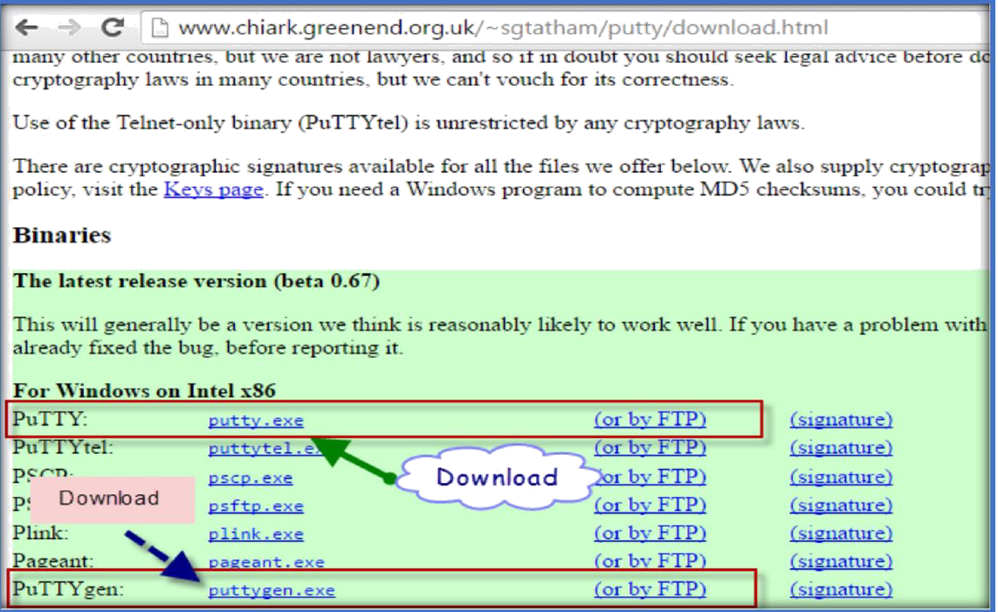
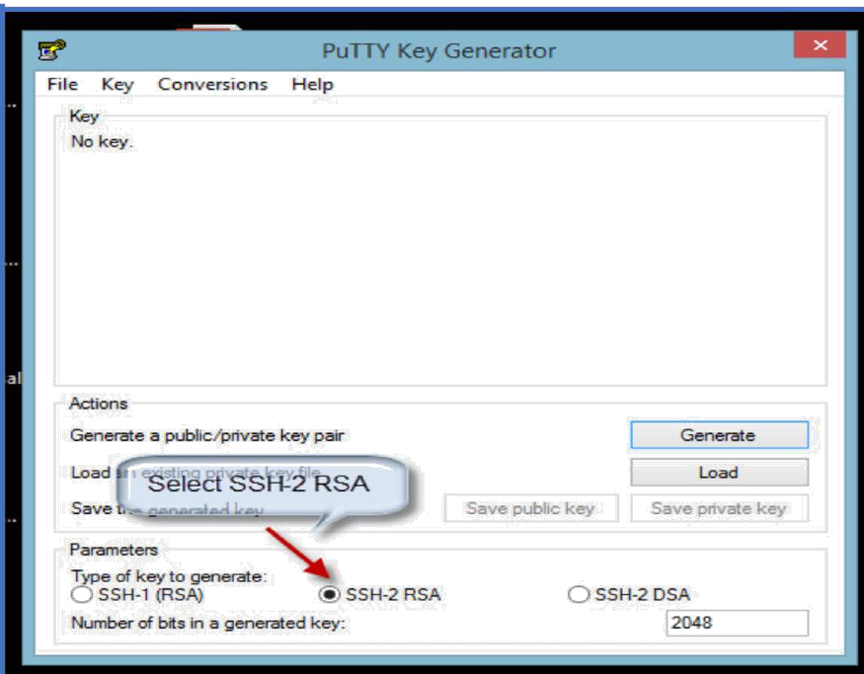
Then, putty does not support PEM file authentication, so we have to convert PEM to PPK by using a app called PuTTYgen, as we have already downloaded. Once downloaded double click on the app will open, no need to install.
Open Puttygen.exe and select SSH-2 RSA in the below.

Slide 14
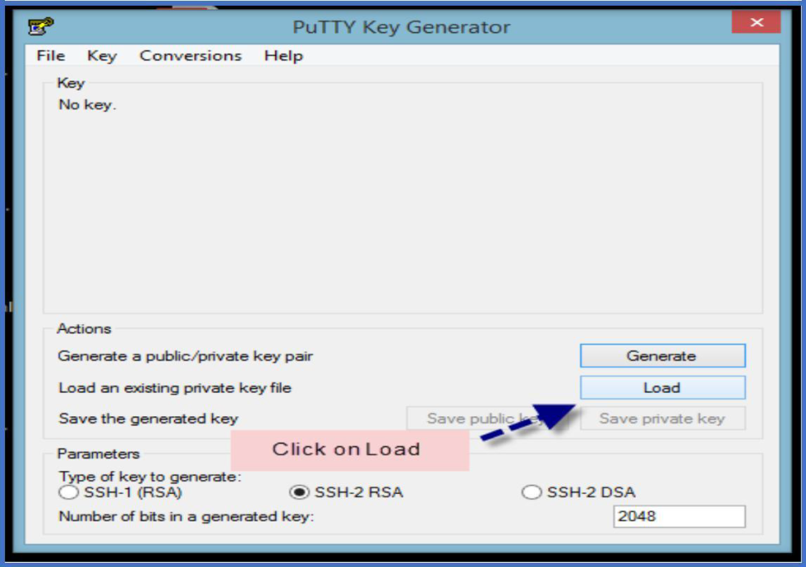
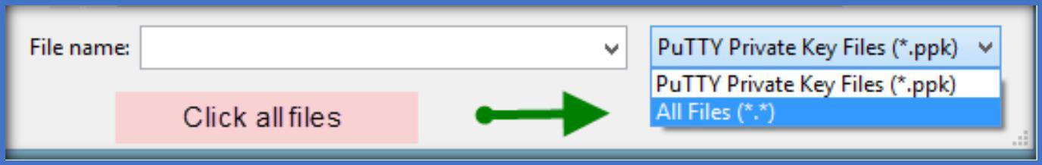
Click on Load to load the PEM file.
Once you click on Load, by default, Puttygen displays only files with extension. ppk. To locate your .pem file, select the option to display files of all types
Select your .pem file for the key pair that you specified when you launch your instance, and then click Open. Click OK to dismiss the confirmation dialog box

Slide 15
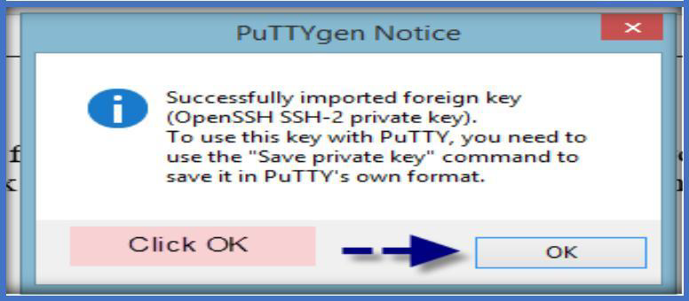
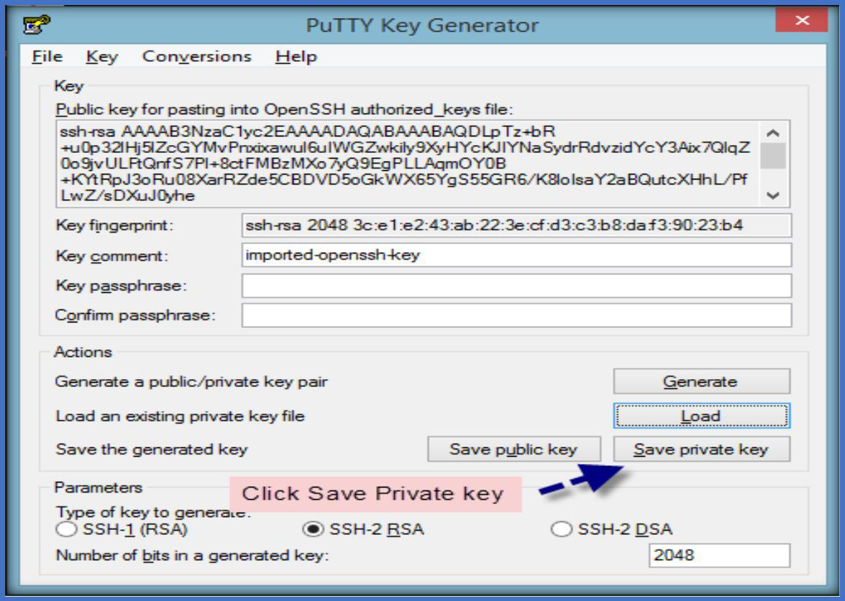
Click Save private key to save the key in the format that PuTTY can use. PuTTYgen displays a warning about saving the key without a passphrase. Click Yes

Slide 16
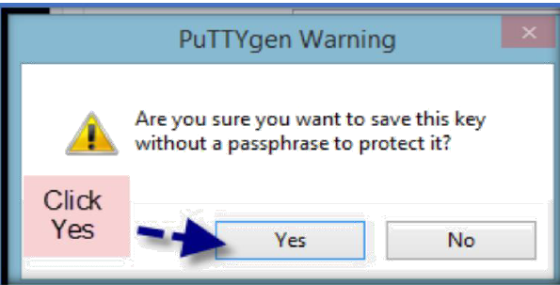
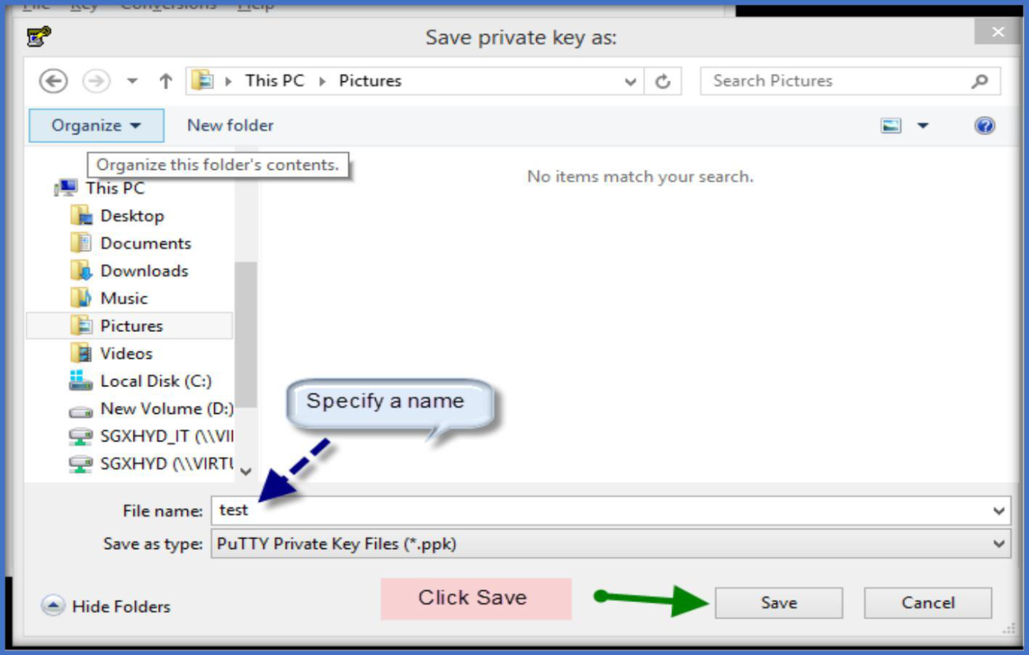
Then specify a name to the ppk file and click save.

Slide 17
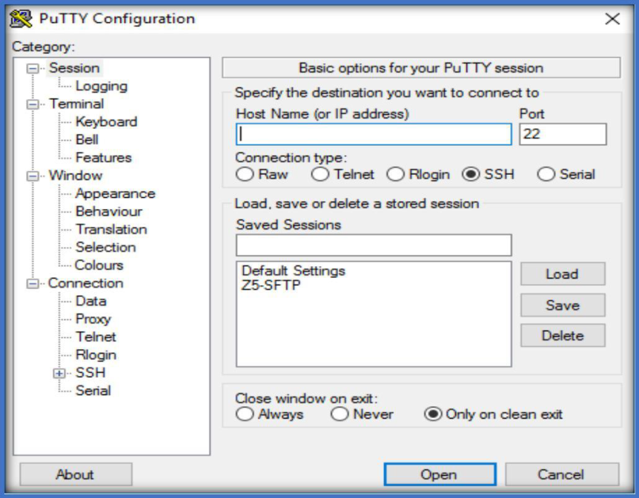
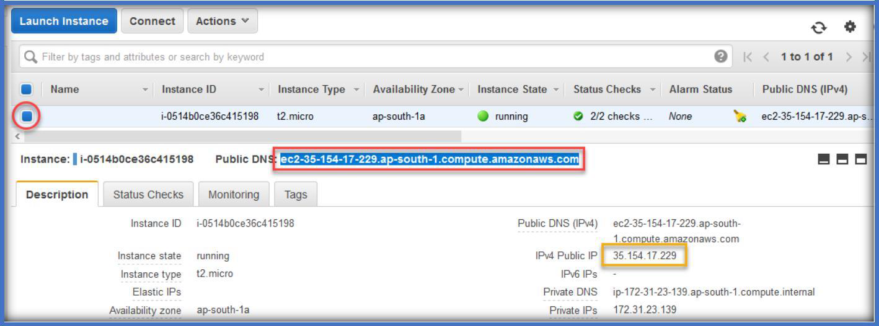
Now open the PuTTY app to start connecting to Linux instance, by double click on it.
Then go to AWS management console, select the instance and copy either Public DNS or Public IP.

Slide 18
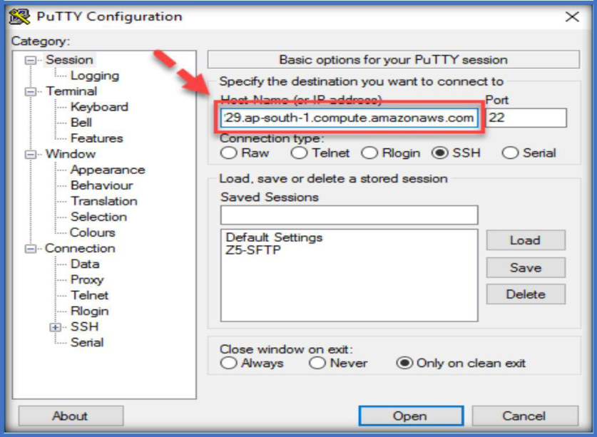
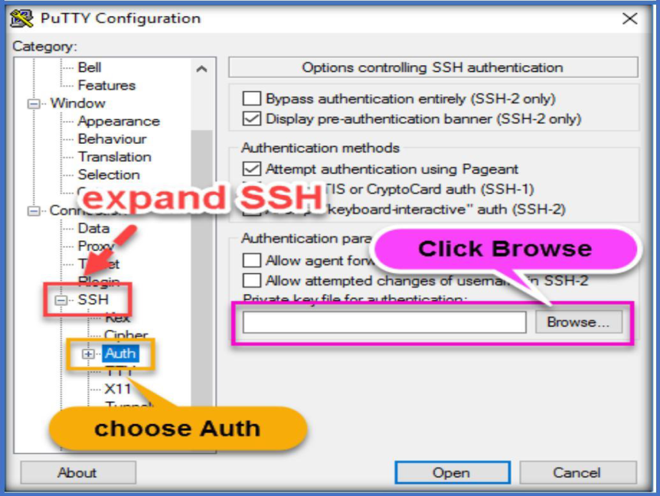
Then paste that in the Hostname or IP Address text box in the PuTTY app.
Then expand SSH under Connection, Choose Auth, then click on Browse from left

Slide 19
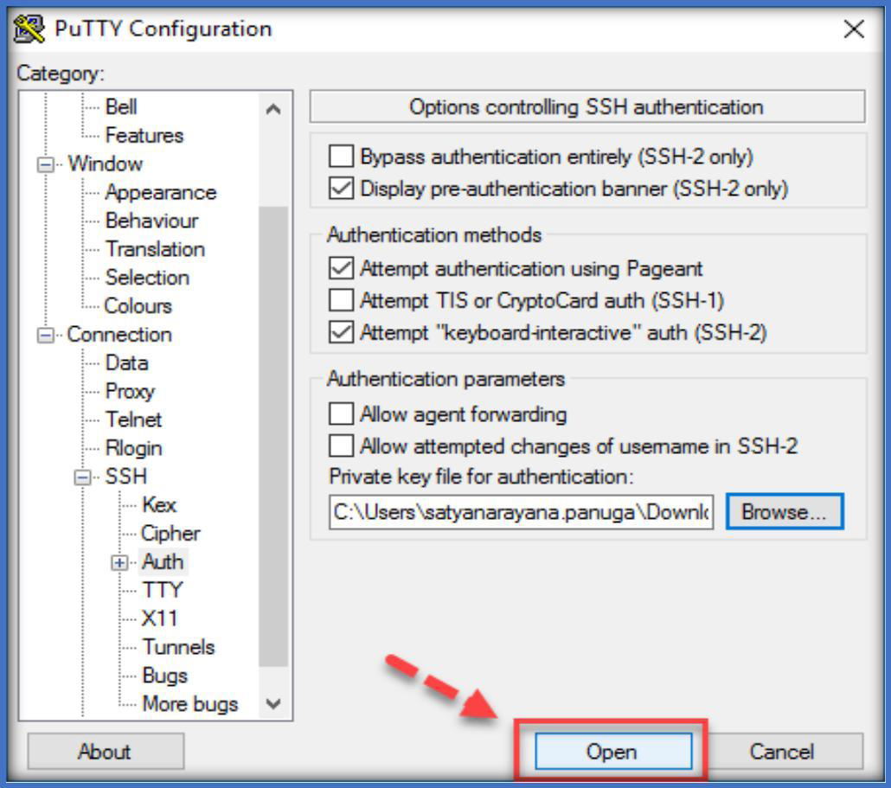
Choose the PPK file which we converted and click on open.
Next, choose Open on the PuTTY app, to connect to the Linux instance.
Next, choose yes.

Slide 20
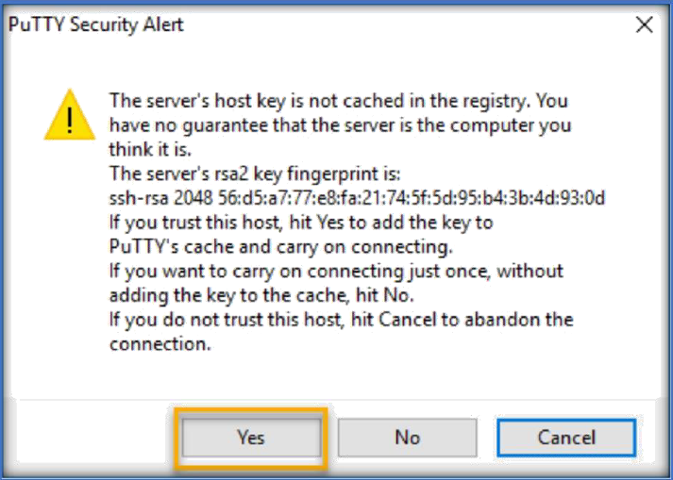
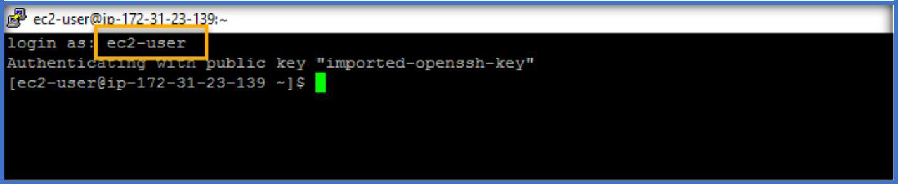
Now enter the username based on the Linux distro and enter to connect.

Slide 21
Find the below default usernames for the different Linux distributions.
LINUX DISTRO | DEFAULT USERNAME
AMAZON LINUX | ec2-user
REDHAT | ec2-user
CENTOS | root
UBUNTU | ubuntu
SUSE | ec2-user
DEBIAN | admin

